Slide 1


Team 42: Multi-Axis Cobot for Factory Automation
Bi-Weekly Update 2 Emily Hamsa, Ethan Woods, Adrian Guzman, Jaishil Shah Sponsor: Matthew Krebs TA: Vishwam Raval
Notes:
Michelle

Slide 2

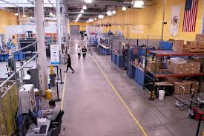
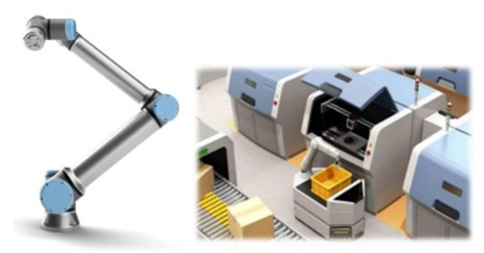
Project Summary
Problem statement:
Factory settings pose dangerous environments to human workers through the exposure to heavy machinery, tight spaces, and repetitive workloads. These hazards increase chance of injury and worker burnout. We need to implement collaborative robots (Cobots) to improve worker conditions.
Human Injury & Burnout in Warehouses
Cobot Solution
Notes:
Adrian

Slide 3
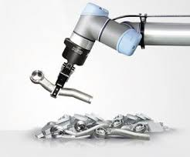
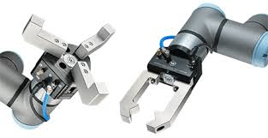
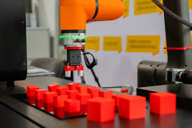
Project Summary
Solution proposal:
Develop a Cobot that can integrate into a factory environment to reduce human injury, worker burnout, and increase productivity in repetitive tasks. The Cobot shall be able to lift (1-2 lbs) and be placed into tight environments and controlled wirelessly through mobile app.
Repetitive Tasks
1-2 lbs. Load
Precise Control
Notes:
Ethan

Slide 4
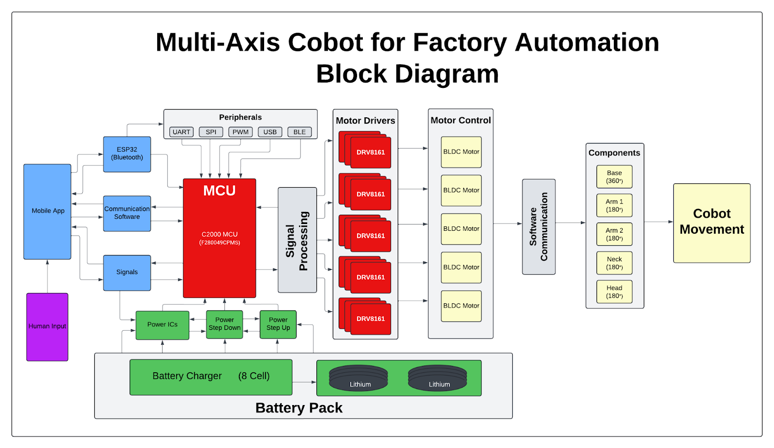
Project/Subsystem Overview
Adrian
Ethan
Jaishil
Emily
Subsystem Diagram Color: Power, MCU/Connectivity, Mobile App, Motor Control

Slide 5
Project Timeline
Review/update progress since E403
Team finalizing design of new PCBs
Order PCB and components
Conversation over physical structure of cobot arm…(Amazon purchase with 1x BLDC motor and 3x-4x Servo)
Team is fixing issues with integration between subsystems
Reviewing bugs/fixing problems
Cobot arm should have clear path and deliverables
Team is fully integrated and operational
Cobot arm is moving
Fix issues with accuracy and movement of arm
Update #2 (Feb 3)
Update #4 (Mar 3)
Final #6 (Apr 7)
Update #1 (Jan 15)
Update #3 (Feb 17)
Update #5 (Mar 24)
Finish putting together new generation boards
Test and validate to ensure functionality
Cobot arm delivered and brainstorm ideas
Integration should be nearing completion
Cobot arm is revamped and near operation
Issues should be resolved with subsystems
Cobot arm is working as expected and can pick up objects that meet the restrictions
Team is making project look visually appealing
Cosmetic touch ups
Notes:
Required:
High level figure showing where you are at in the project, what’s completed, what’s underway – it should take about 30 seconds to summarize where you are in the timeline
-- Save discussion for subsystem update
-- Save detail for execution plan & validation plan status

Slide 6
Motor/Motor Driver Subsystem
Ethan Woods
Accomplishments since last update 15 hours of effort | Ongoing progress/problems and plans until the next presentation
Finished Final Board Design PCB Layout and Routing Most parts have arrived from ordering Only missing TI Components Organized components and parts Started soldering process | Complete and Verify soldering work Test Power Planes Test Signal Outputs Launchpad Testing Begin Integration with MCU Subsystem Begin Integration with Physical Design

Slide 7
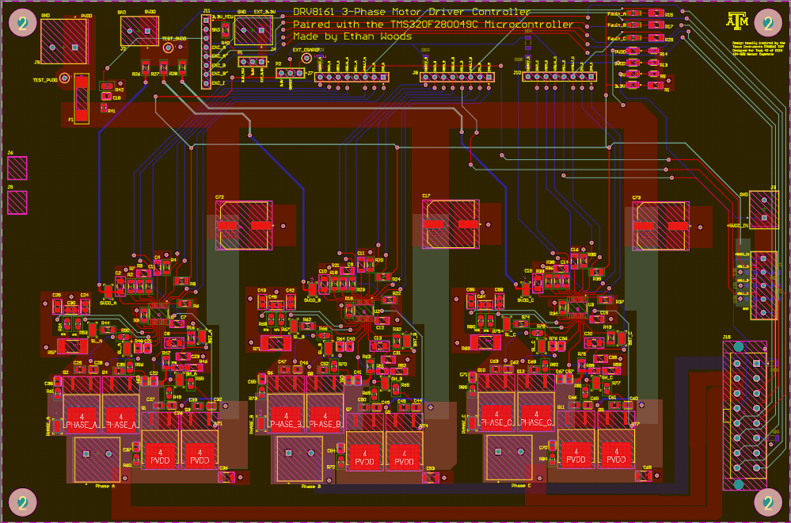
Motor/Motor Driver Subsystem
Ethan Woods
Final Design Specifications:
3x Phase Output Circuits
3.3V, 5V, 12V, 48V Power Inputs
30+ Input/Output Connections for MCU Integration
Hall Sensor/Encoder Connections
3-Phase BLDC Motor Connector
Once soldered, testing will begin with the MCU subsystem to run previously created code to produce movement for the 3-Phase BLDC motor.

Slide 8
MCU/Processing Subsystem
Adrian Guzman
Accomplishments since last update 20 hrs of effort | Ongoing progress/problems and plans until the next presentation
Successfully soldered new board Debugged MCU board continuity tests, power check, JTAG test to confirm programmability Completed 3V3 check with power supply, ready for power subsystem integration Completed ESP32 check and ready for integration with wireless subsystem Preliminary code written based off TI’s GUI.c code, supporting MCU to Motor Driver integration Flashed program onto MCU board in preparation for integrating with Motor Driver Subsystem | Integration with Motor Subsystem Refine MCU code based on GUI.c Use oscilloscope to probe pins Integrate with motor driver this week and see what needs to be fixed Integration with Power Subsystem Connect to 3v3 terminal blocks, ensure power of MCU board Integration with Wireless Subsystem Integrate and test mobile app input to the MCU
Notes:
Required: What has been accomplished (not just started) – is it back up and running from 403? | What are you going to accomplish in the next 2 weeks | -- “Started, began, initiated…” are not accomplishments
--You do not need to have any accomplishment on some updates if you describe in “Ongoing” what work you have been doing
-- Make things here specific and measurable/verifiable

Slide 9
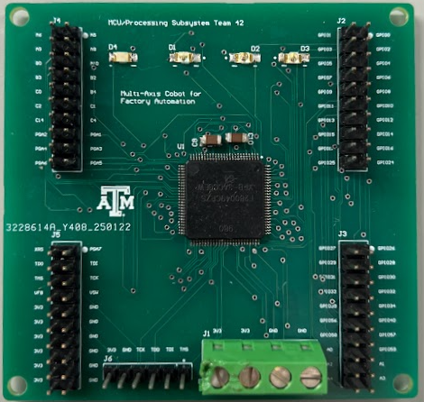
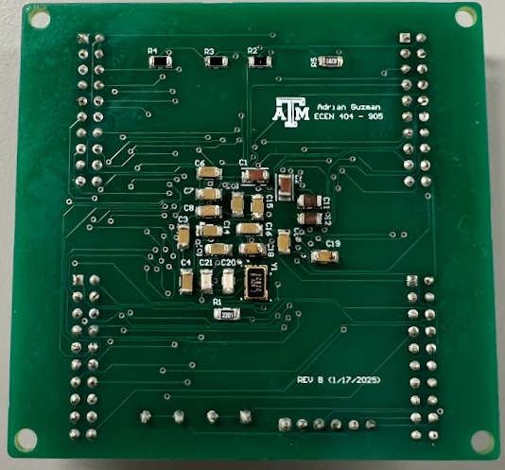
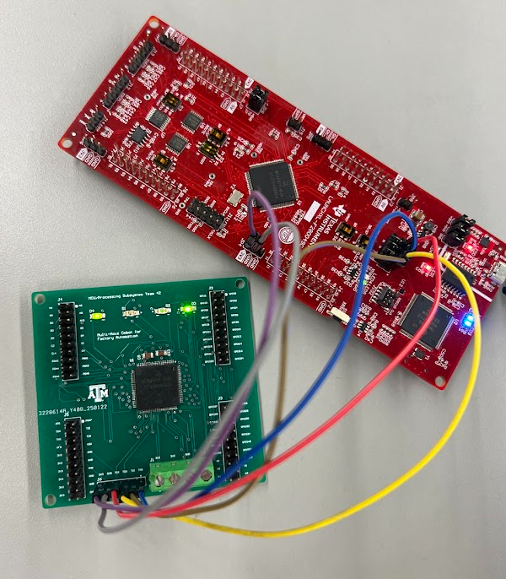
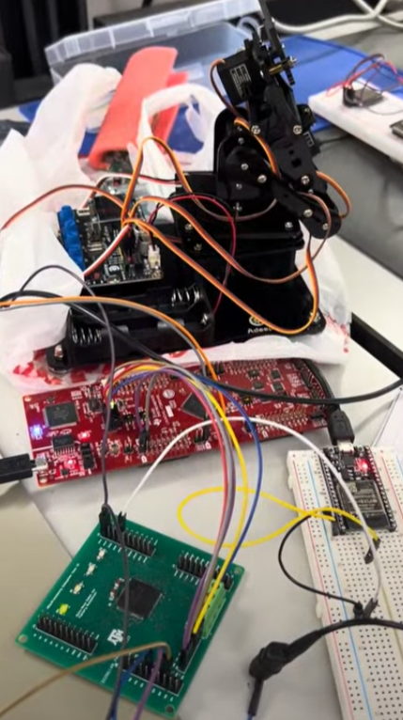
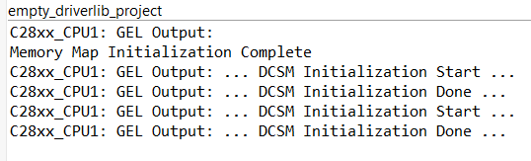
MCU/Processing Subsystem
Adrian Guzman
GPIO Toggle LED
3V3 LED
Front
Back
JTAG pins
All programs written last year work on new PCB board.
Ready for integration with power & wireless
ESP-32 verified functional, pending wireless app to fully check off
Ready to integrate with motor driver
Expect to fix things as we integrate these two subsystems
Program that moves cobot arm side to side via C2000 MCU
Successful Flash of MCU
Notes:
Required: Interesting figure related to your subsystem progress. Detail on what works, what doesn’t, what is changing.

Slide 10
Power/Battery Management Subsystem
Emily Hamsa
Accomplishments since last update 20 hrs of effort | Ongoing progress/problems and plans until the next presentation
Completed new board design and routing in Altium Ordered and received board and components Assembled robotic arm in preparation for integration Completed Red Badge training and brainstormed new physical design ideas | Solder and test board to prepare for integration Ensure voltage outputs and current tolerances are as expected Continue work on physical design Begin work on physical design
For 2nd review should all be in the context of your integration plans! For example:
“Completed X-function in preparation for integrating with Y-subsystem”
“Tested integrated motor controllers with MCU by verifying full range of motion on
all 6 joints with no load and 0.5kg load”
“On-going integration of motor control system with MCU”
“By next review will integrate with android app”

Slide 11
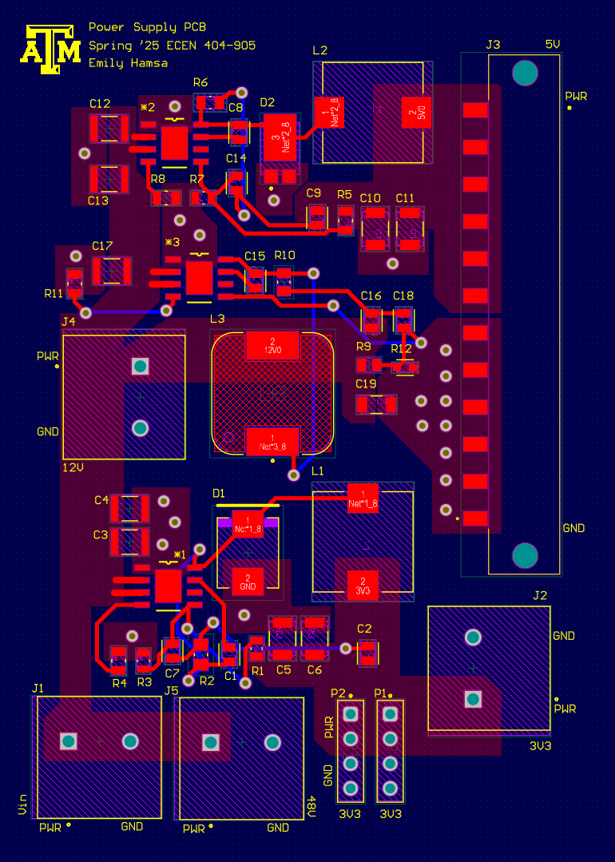
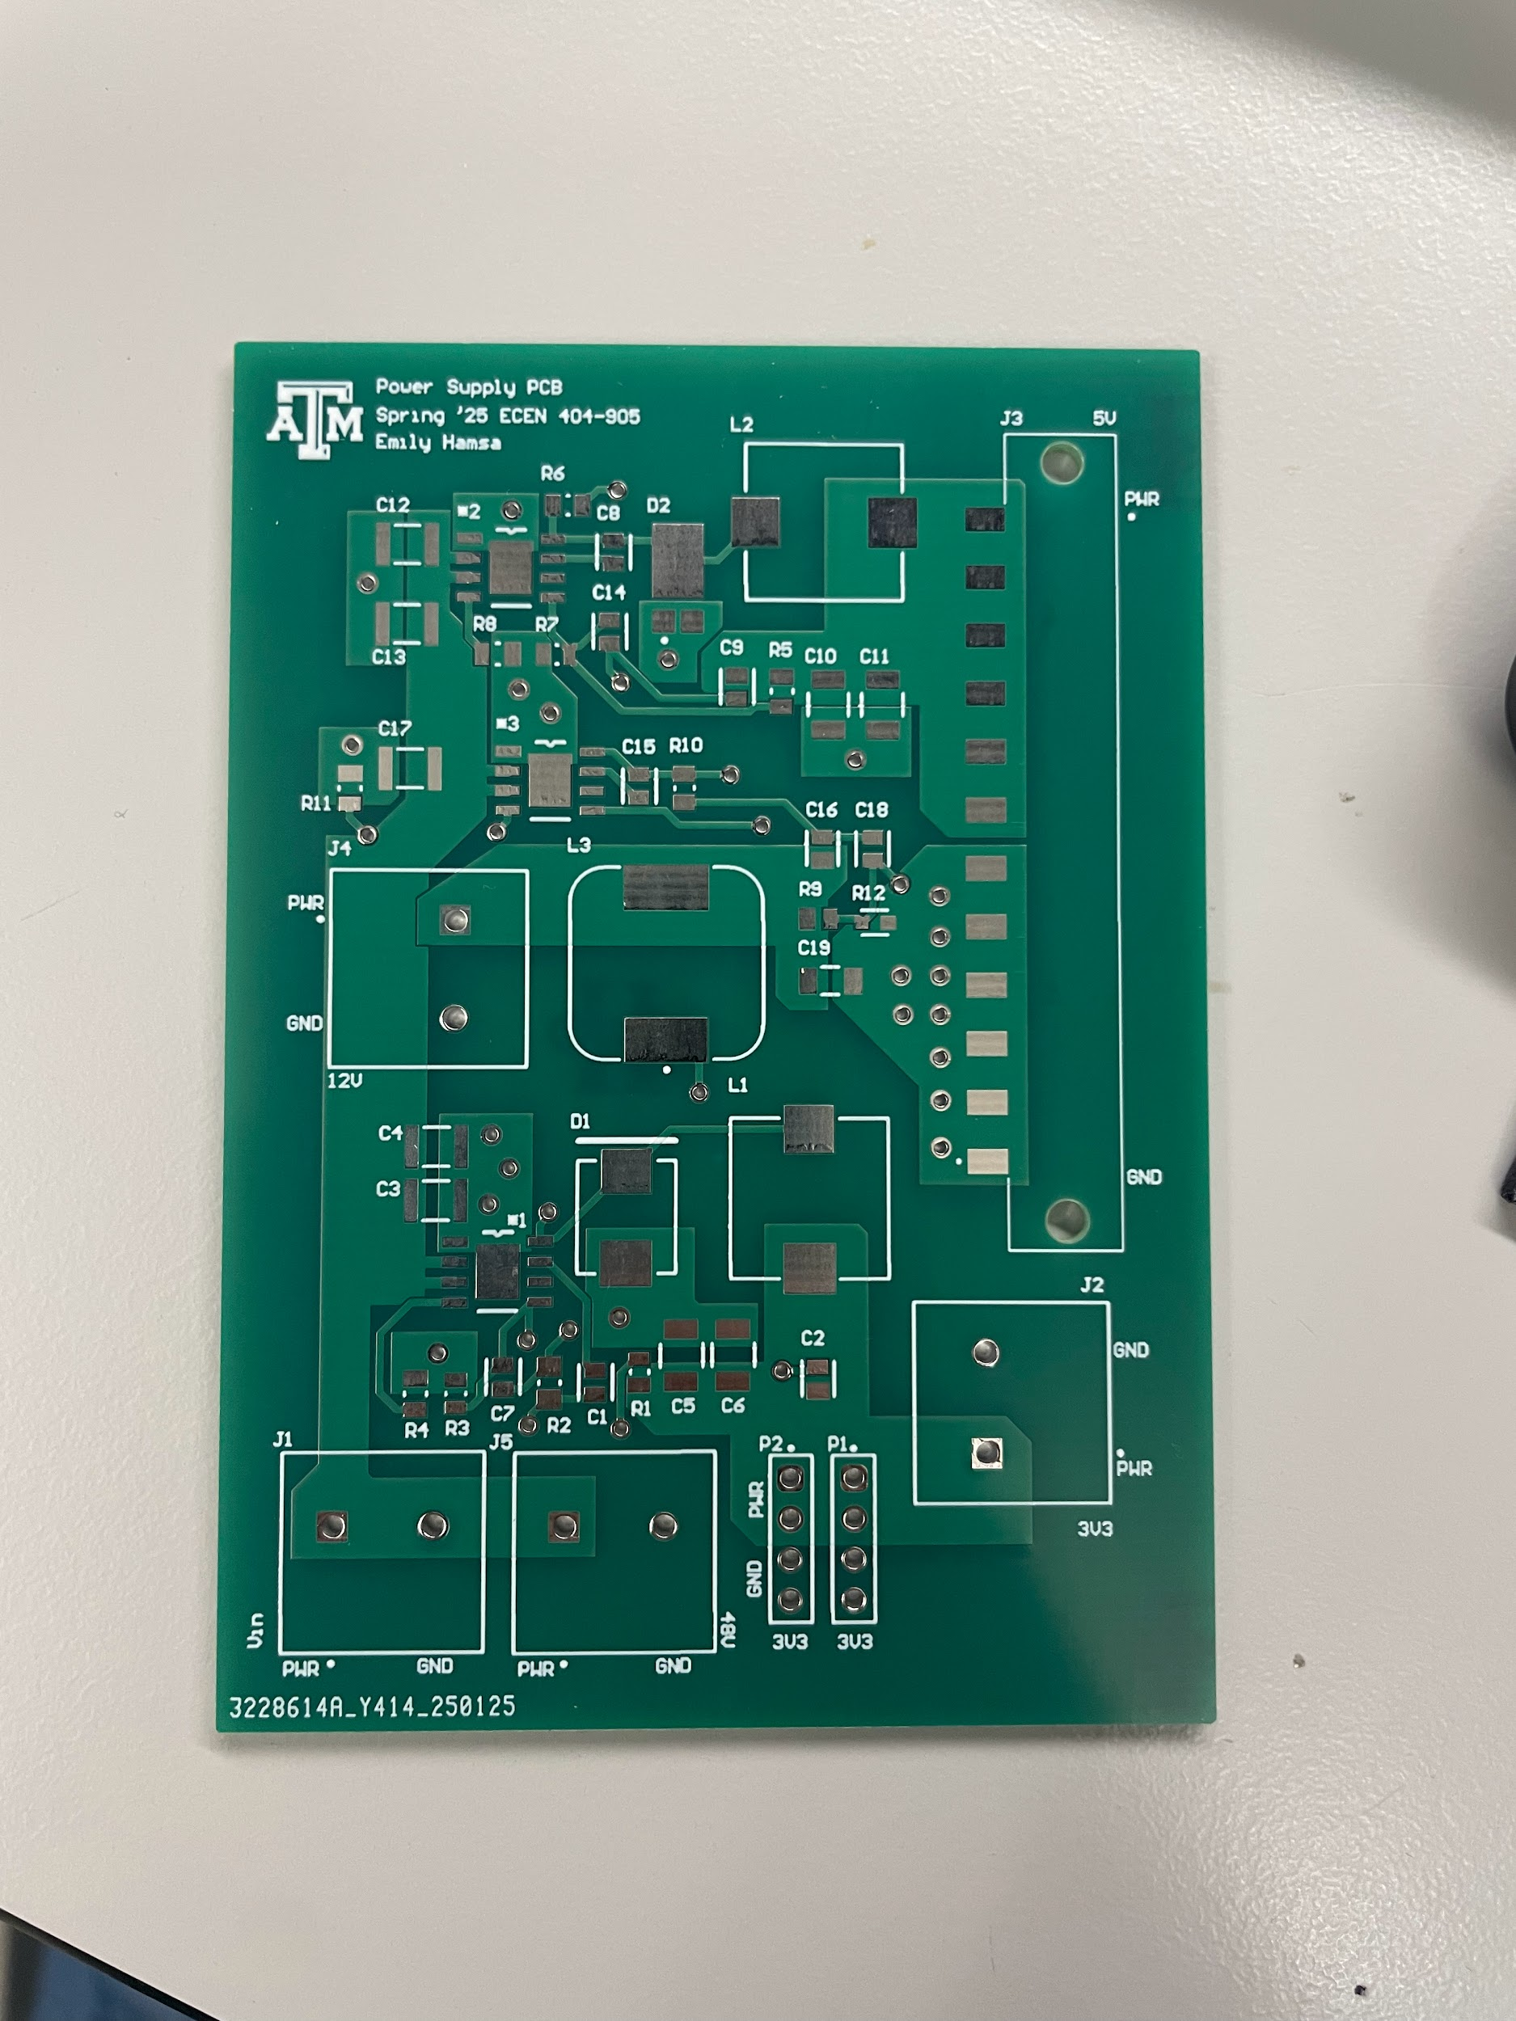
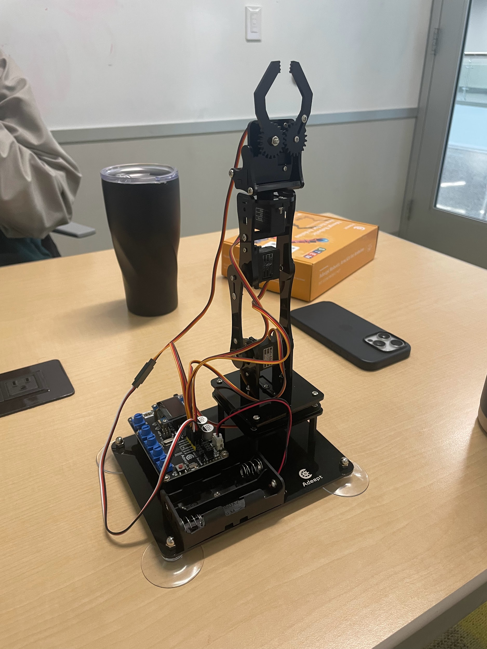
Power/Battery Management Subsystem
Emily Hamsa
Interesting figure related to your subsystem
progress ---
Best to show:
Results from prep for integration => integration
=> test of integrated subsystems
Final design including polygon pours and signal planes to solve testing failures from 403
Printed Board
Robotic arm fully built and ready for modifications and integration
Robotic Arm
Final Design
Printed Board

Slide 12
UI/Wireless Connectivity Subsystem
Jaishil Shah
Accomplishments since last update 20 hrs of effort | Ongoing progress/problems and plans until the next presentation
- Assembled the Cobot alongside Emily and confirmed functionality - Obtained my Red-Badge and have began the physical structure redesign - Confirmed ESP-32 functionality with the cobot via Mobile Application - Confirmed manual final demo (picking up small object via potentiometers connected to each motor joint) | - Finish Mobile Application complexity and final iteration for integration - Solidworks sketch/design of physical structure redesign - Accomplish wireless communication with the MCU & motors

Slide 13
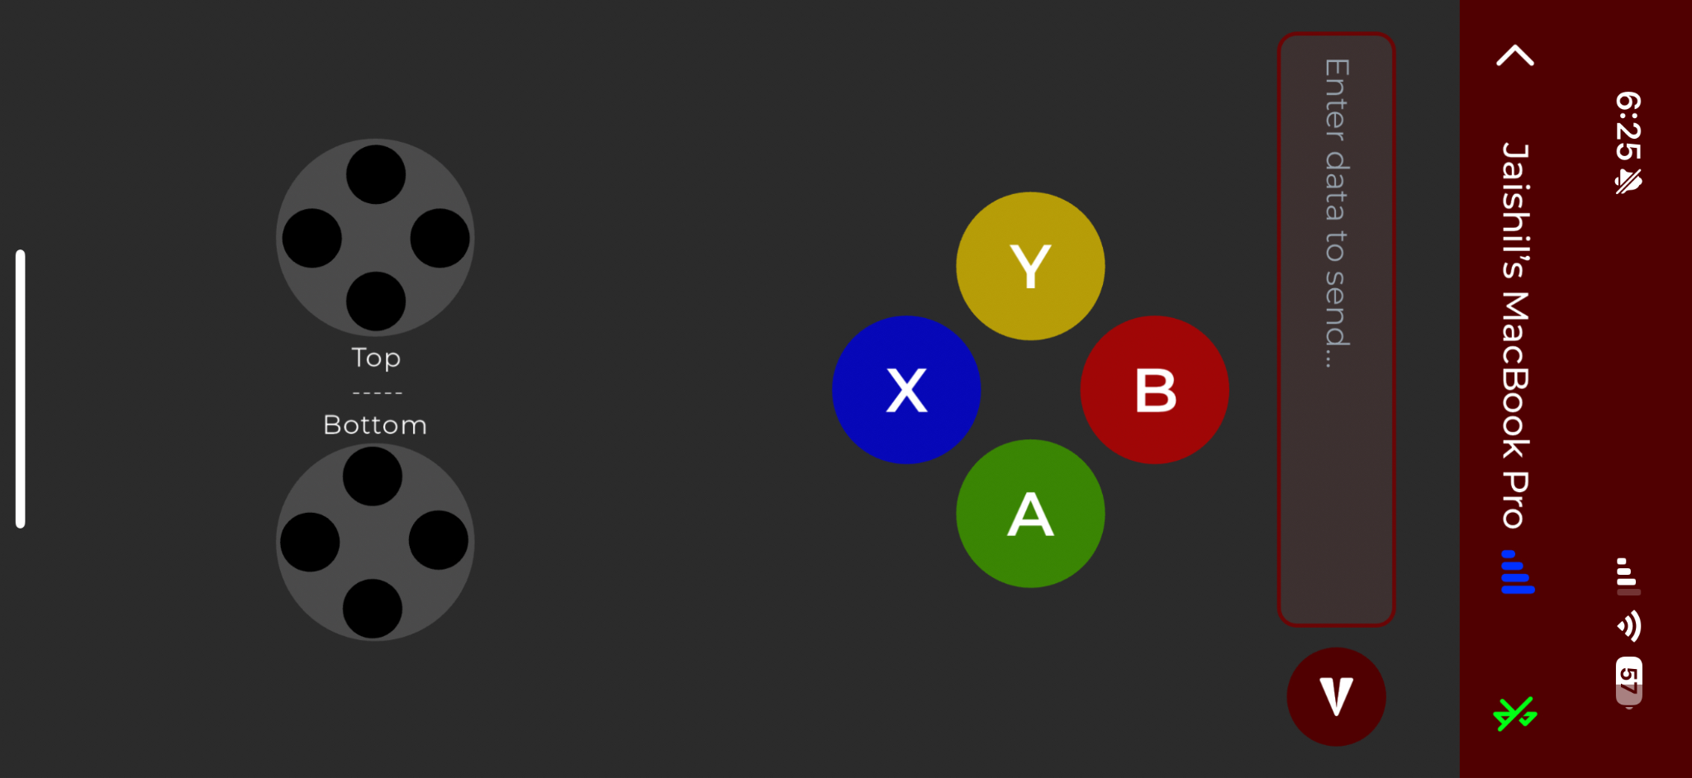
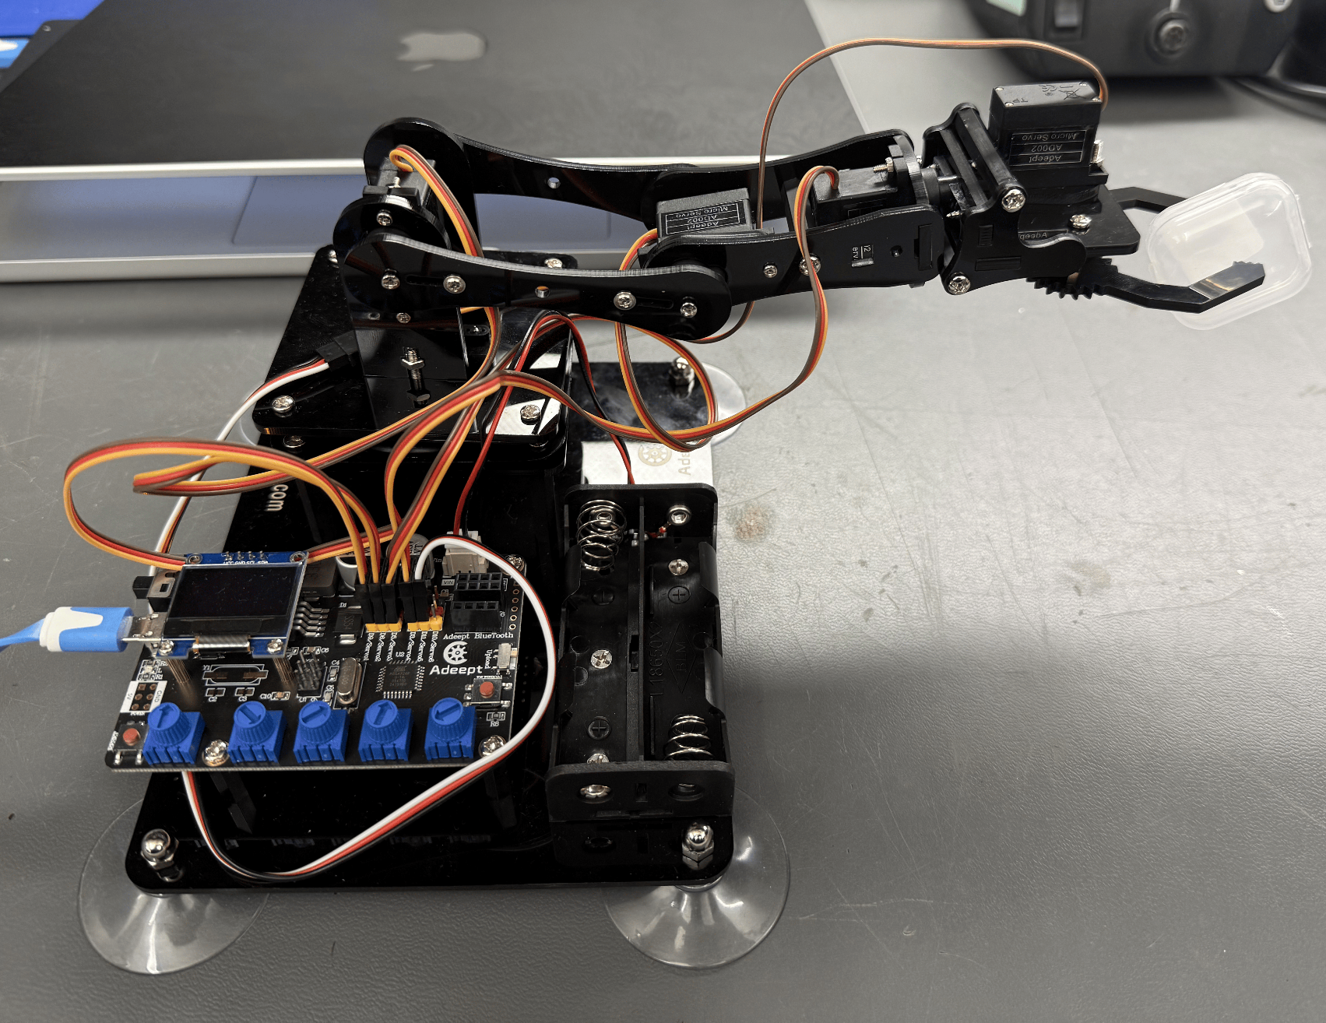
UI/Wireless Connectivity Subsystem
Jaishil Shah
- Mobile Application → ESP-32 → UART → Cobot
- Once fully integrated, the ESP-32 will connect to the MCU instead of directly to the cobot due to motor/driver integration
- Deciding between 3D-printed design & acrylic base (with wood underneath for structural support) for final integration
- Once team members’ boards are completed this week, proper integration will become the first priority
Next week, the goal is to have a physical design prototype with all dimensions and constraints figured out
Next Steps:
- Complete SolidWorks sketch of physical design
- Finish final application iteration
- Integrate all four subsystems

Slide 14
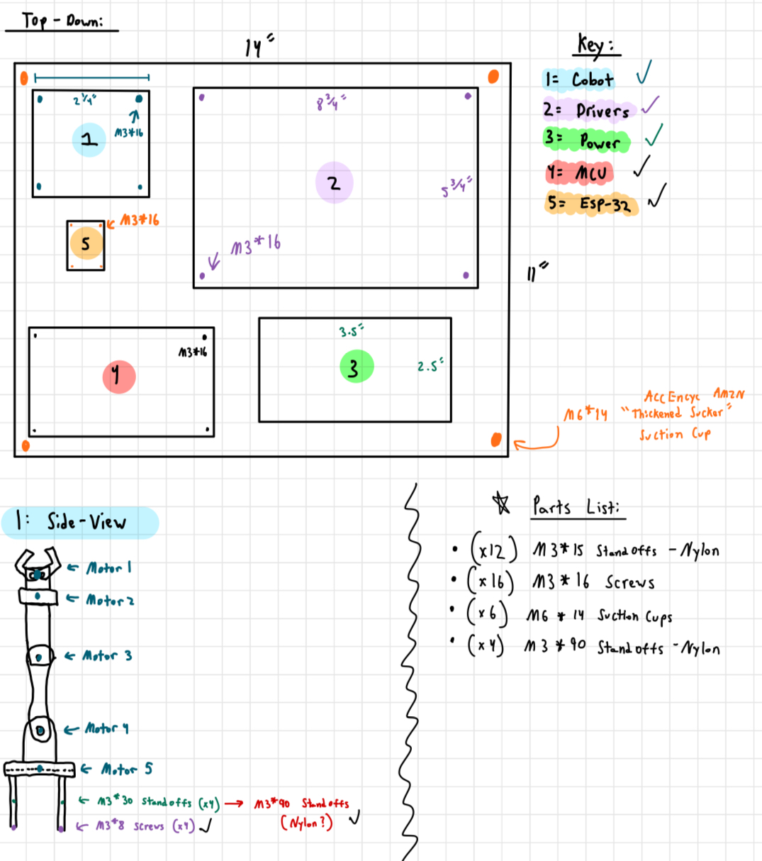
Physical Apparatus Design:
(Prototype)

Slide 15
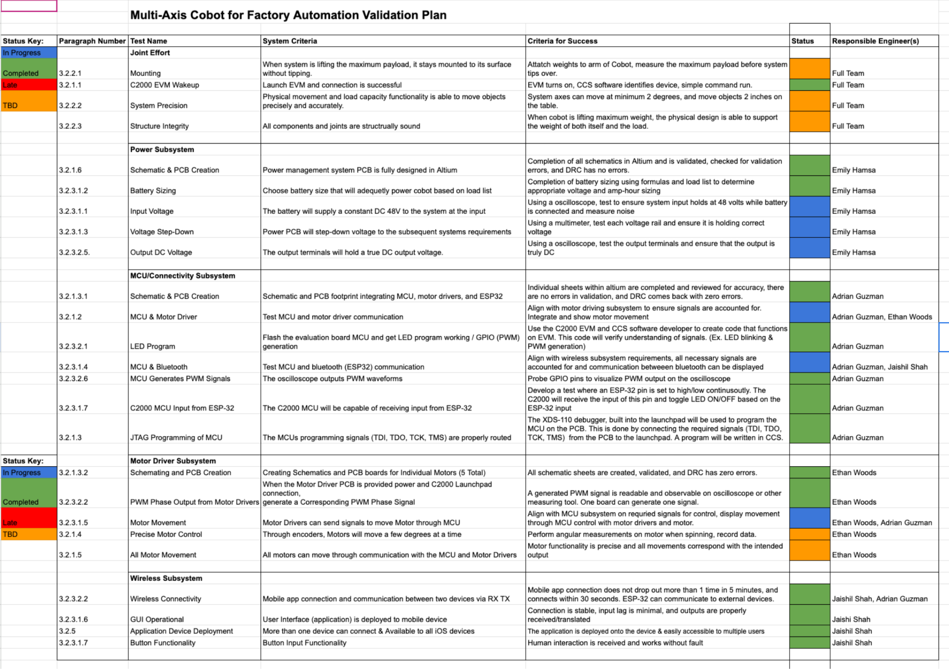
Validation Plan ECEN 404
Notes:
Required:
Execution plan
Your team planned milestones for completion of any remaining subsystem functionality, integration of specific subsystems, test, and validation plans should be presented.
Milestones should have owners … things like final integration can be group owned
Gantt chart – should indicate some 404 progress.
Try to complete all subsystem function in next 3 weeks.
Try to complete all integration 2 weeks before demo to allow for system validation and documentation

Slide 16
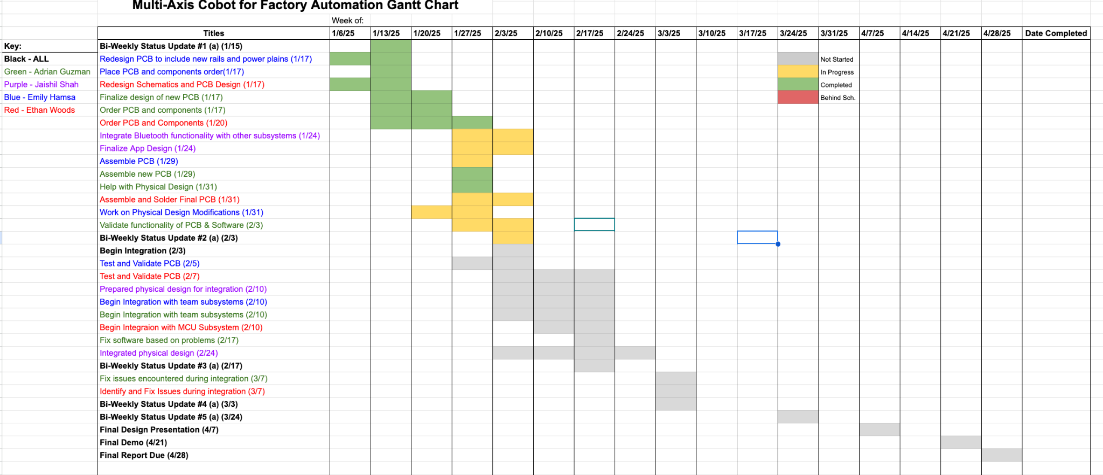
Execution Plan ECEN 404

Slide 17
Thank You!

